Slide 1
Business Intelligence Unit-v
By: Dr. Rajeshvari Trivedi
DSVV

Slide 2
UNIT-V
ENTRERPRISE REPORTING:
Basics of Enterprise Reporting:
Features of good reporting,
Common report layout types,
Report delivery formats,
Report standardization and presentation practices,
Brief introduction to Balanced scorecard, and Enterprise dashboards,
Balanced scorecards vs. Enterprise dashboards.

Slide 3
Business intelligence is a system of various solutions used to garner insights from different types of data.
Driving business decision making is the primary use of business intelligence and is accomplished by utilizing different techniques to understand historical, live, and predictive data.
Reporting is a foundational part of business intelligence which focuses on visualizing data in different types of visualizations such as tables, graphs, and charts.
Visualizations within the context of reporting are a graphical representation of data, the goal of which is to accurately present information in a form that is digestible to end users.
In the past, visualizations created for the purposes of reporting were static, meaning data could not be manipulated on the visualization itself.
As the needs of business have changed over time, so too has reporting evolved. In the fast changing world of business today, more and more interactivity has become essential to executives needing to make quick business decisions, on the fly.

Slide 4
Data manipulation, such as drilling down to different semantic layers of data, slicing and dicing of information through sorting and filtering, and a vast array of others, which in the past was reserved only for technically experienced data analysts and scientists, can now be put in the hands of non-technical end users either through an external tool or within an application itself.
In recent years, end user interactivity has been taken a step further with ad hoc reporting. Ad hoc reporting allows end users to create reports from scratch as well as further edit and manipulate pre-built or canned reports. The ability to create, edit, and save reports for future use has empowered end users more than ever before allowing for quicker visualization of pertinent business data.

Slide 5
More advanced reporting systems allow for paginated reports, pixel perfect reports, as well as a variety of delivery methods meant to make development teams and administrative staff’s life easier.
Paginated reports are reports that are separated into different pages allowing them to be easily printed. Pixel perfect reports are reports where each individual element of the report can be customized down to the pixel level in both size and location, and are often used for situations which require detail perfect reports such as tax or regulatory documents.
Another large part of reporting is the ability to deliver reports in a variety of different formats, such as the ability to export to .pdf, .csv or excel, send via email, or upload to FTP as well as many others.
The ability schedule reports to run at a given time or time period is also an important feature which allows teams to run and send reports without manual creation or intervention.
Report bursting is another essential feature of enterprise reporting where a single report can be sent to multiple users with different levels of data permission allowing them to receive a report customized to the data they need to are allowed to see, this saves the time and energy needed to create individual reports for every person with a different permission set.

Slide 6
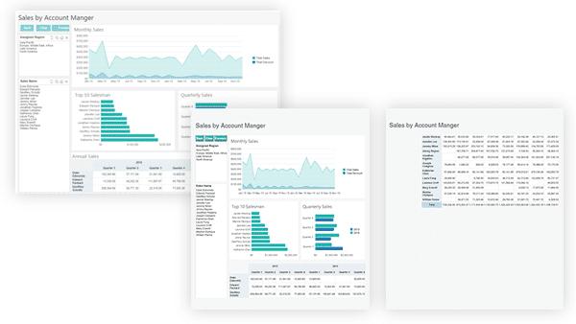

Slide 7
ENTRERPRISE REPORTING
Enterprise reporting (or management reporting) as the regular provision of information to decision-makers within an organisation to support them in their work.
These reports can take the form of graphs, text and tables and, typically, are disseminated through an intranet as a set of regularly updated web pages (or "enterprise portal"). Alternatively, they may be emailed directly to users or simply printed out and handed around, in the time-honored fashion.

Slide 8
Goal of a Reporting Tool
The purpose of reporting tools and business intelligence tools are to translate data into actionable information.
Reporting should fit within your strategic business goals in order to be useful. There are also many use cases for reporting tools from managing performance data to allowing your customers to leverage reporting of their own data.

Slide 9
Reporting for Business Intelligence
Reporting, in the context of business intelligence, is one of the base components and, as mentioned, is functionally involved in the early stages of analysis. Mainly, reporting plays the role of visualizing data.
It does so by utilizing a number of different components from charts, graphs, tables, as well other widgets. A report can be made up of one of these component parts, or many of these component parts.
These component visualizations are used to represent data in different ways, but all are used for the purpose of presenting information in an accurate and usable way to end users.

Slide 10
Visualization and Reporting
visualizations contain many different ways to interact and manipulate data. The increased levels of interactivity, which have evolved as business needs have, means that the way in which users interact with reports has changed. What used to only be simple visualizations of data, are now being used more and more for the purposes of data discovery, and in some cases full-fledged data analysis.
This means that the ability to slice and dice and drill down/through data, utilize formulas, and even some base level data modeling is now being moved from the hands of dedicated data scientists and analysts to the hands of non-technical decision makers. With this added functionality, the ability to make more objective, data-driven decisions is becoming easier an easier.

Slide 11
Features of good reporting
Ranking Reports
Ranking reports let you easily view the best- and worst-performing facets of your business, from products to marketing campaigns to salespeople. You can view rankings across multiple dimensions and specify various criteria to focus your results.
What-If Analysis
If you’re curious about how a future decision will affect your business, you can run a “what-if” analysis using past data to predict the potential impacts. Tools for what-if analyses give you an objective view of the risks and rewards involved in each potential decision, and allow you to plan better for the future.
Executive Dashboards
Executive dashboards give your organization’s leaders a real-time overview of your business in the form of graphs, charts, summaries and other information reports. They allow your company’s executives to make smarter, faster and better decisions.
Interactive Reports
Interactive reports allow users to condense the massive amounts of collected data into a wide variety of possible views. Users can take advantages of features like statistical analysis and regression to identify trends, anomalies and outliers in the data.
Geospatial Mapping
Applications using location intelligence can take your information and transform it into graphical and cartographic representations, simplifying your geographical data. At a glance, judging which regions are performing better than others — and which ones need particular attention — becomes much easier.

Slide 12
Features of good reporting
Operational Reports
At the end of each day, business intelligence features like these can provide your organization’s executives with a detailed summary of the daily events, giving them the information they need to make critical decisions.
Pivot Tables
Pivot tables can automatically extract significant features from a large, messy set of data. They can perform calculations such as sorting, counting or averaging the data stored in one table, and show the summarized results in another table. Pivot tables are essential tools for analyzing information and uncovering hidden trends.
Ad-Hoc Reports
Instead of burdening your IT department with requests for detailed reports, ad-hoc reports are one of several important features of BI that let your nontechnical end-users generate their own reports on the fly. Users can pick and choose the elements that they wish to be included in the report, emphasizing only those aspects that are relevant to their query.
User-Specific Security
If you need to restrict certain users’ access to particular data sets, your BI tool should allow you to personalize your BI features and applications to individuals or groups of users. Some solutions provide user-specific data sources, where a single application pulls from different sources of data depending on who’s using the application.
Open Integration
Smart BI platforms will be able to access not only your organization’s own data, but information from email, social media, websites and more. For example, instead of only providing your internal sales data, your BI platform could accompany that information with reviews and comments about your products.
With so many data formats and so many applications to pull from, it’s important that your BI platform is able to integrate as many different types of data as possible under a single roof, seamlessly combining disparate forms of information into an actionable report.

Slide 13
Common report layout types
Metric Management - In many organisation, business performance is managed through outcome-oriented metrics. For external groups, these are Service Level Agreements (SLAs). For internal management, they are Key Performance Indicators (KPIs). Typically, there are agreed targets to be tracked against over a period of time. They may be used as part of other management strategies such as Six Sigma or Total Quality Management (TQM).
Dashboards - A popular idea is to present a range of different indicators on the one page, like a dashboard in a car. Typically, vendors will sell you "canned reports" (pre-defined reports with static elements and fixed structure). However, this approach should allow users to customize their dashboard view, and set targets for various metrics. It's common to have traffic-lights defined for performance (red, orange, green) to draw management attention to particular areas.
Balanced Scorecards - A method developed by Kaplan and Norton that attempts to present an integrated view of success in an organisation. In addition to financial performance, they also include customer, business process and learning and growth perspectives. (You should read about this if you're not sure what kinds of things to report on.)

Slide 14
Report delivery formats
Analysis:An analysis, also known as an analysis report, is the most popular resource type. You create an analysis by dragging measures and dimensions onto the design canvas. Once created, you can filter the analysis for particular entries, or use a slicer to dynamically filter the analysis. Double-clicking a cell allows you to drill down to the detail data underlying it. You can also use the right-click menu for operations such as drilling up to a heading's parent level, adding an annotation to a cell, or restricting the analysis to a heading and its subordinate levels. Right-clicking a header cell allows you to edit the heading text.
Analyses are the core tool of ZAP BI because they offer the maximum flexibility in presenting information. For example, you can use an analysis to: create a customer list; compare the sales for two products; create a complex multiple-page report filtered by years; and summarized by a multi-axis chart.

Slide 15
Analyses also allow you to drill through from the presented data (for example, to a drill-through report detailing each individual sale making up the sales total), and to highlight particular cells using conditional formatting rules to make finding significant discrepancies easy.
By default, analyses are viewed as pivot tables, but they can also be viewed as charts.
These reports are the core tool of ZAP BI, because they allows users to achieve the most with their information (for example, create a simple table, comparing the sales for two products, or create a complex multiple-page report, filtered by years and summarized by a multi-axis chart).
Analyses also allow users to drill through presented data (for example, to a sub-report detailing each individual sale making up the sales total), and create complex highlighting rules to make finding significant discrepancies easy. By default, analyses are viewed as pivot tables, but they can also be viewed as charts.

Slide 16
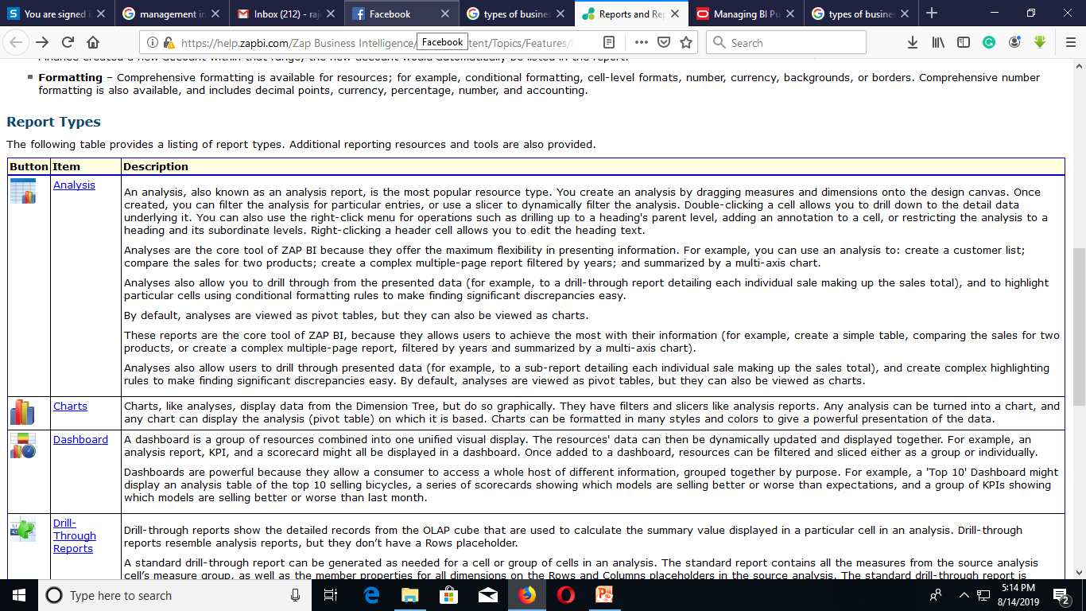

Slide 17
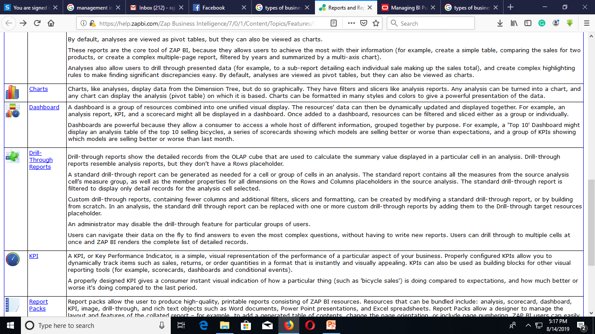

Slide 18
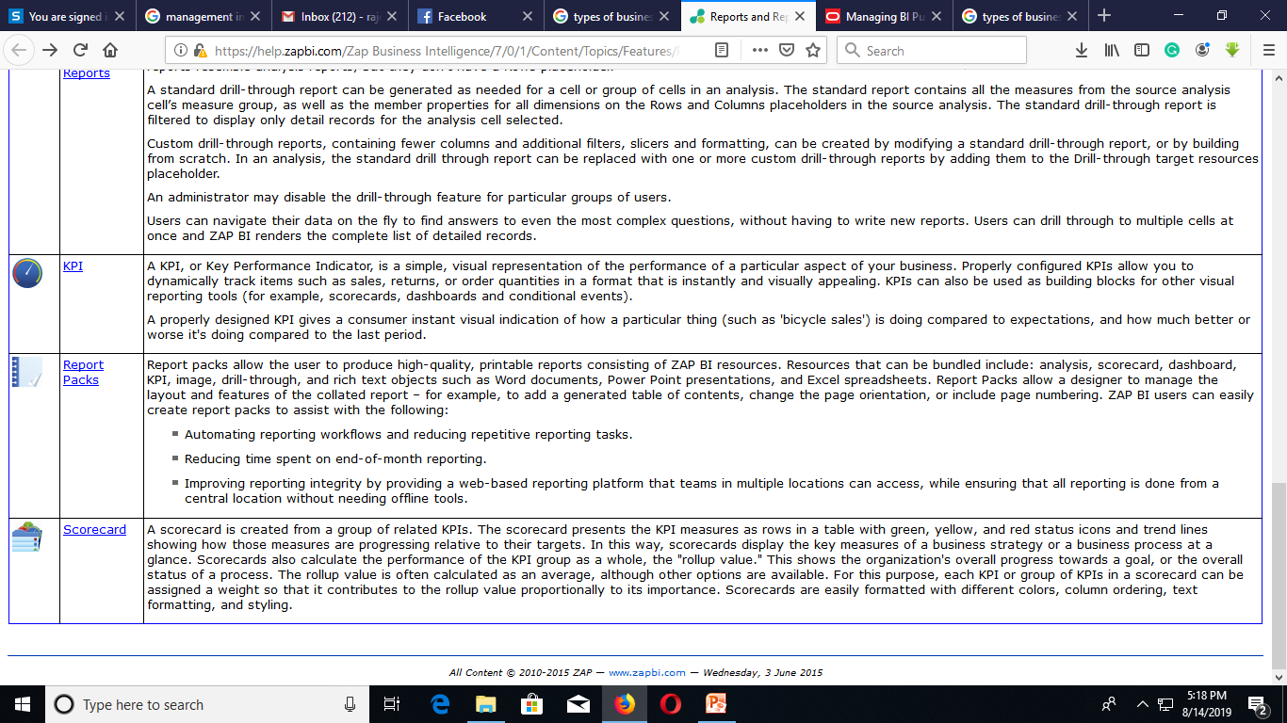

Slide 19
Report standardization and presentation practices
Standardization is the process of creating standards to guide the creation of a good or service based on the consensus of all the relevant parties in the industry. The standards ensure that goods or services produced in a specific industry come with consistent quality and are equivalent to other comparable products or services in the same industry.
Standardization also helps in ensuring the safety, interoperability, and compatibility of the goods produces in the market. Some of the parties that must be involved in the standardization processes include users, interest groups, governments, corporations, as well as standards organizations.

Slide 20
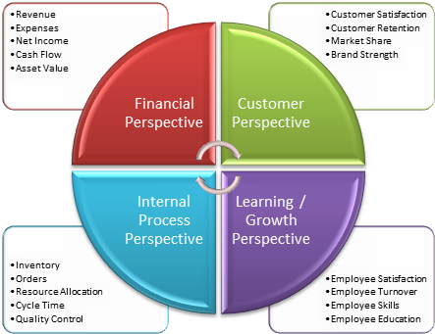
Balanced scorecard, and Enterprise dashboards
Balanced Scorecard. A balanced scoreboard is an analysis technique that translates an organization's mission statement and business strategy into specific, measurable goals, and monitors the organization's performance in regards to achieving these goals.

Slide 21
Balanced scorecard, and Enterprise dashboards
An enterprise dashboard provides management and executives with an instant visual representation of their enterprise KPIs.
Online Marketing Dashboard.
Production Analysis Dashboard.
Telecommunication General Management Dashboard.
Power Plant Monitoring Dashboard.
Patient Health Summary Dashboard.
IT Project Management Dashboard.
Financial Management Dashboard.
Website Visitor Analysis Dashboard.

Slide 22
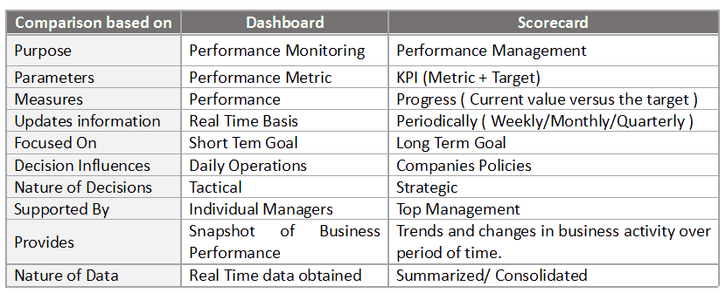
Balanced scorecards vs. Enterprise dashboards

